Slide 2
Eleanor Rigby — The Beatles
“Ah look at all the lonely people
Ah look at all the lonely people
Eleanor Rigby, picks up the rice
In the church where a wedding has been Lives in a dream
Waits at the window, wearing the face
That she keeps in a jar by
the door, Who is it for?”

Slide 3
Genesis 2:18 “And the Lord God said, ‘It is not good that man should be alone; I will make him a helper comparable to him.ʼ”
helper:— (ezer) strong help comparable:— (kenegdo) as in front of him; perfect match,
same nature.

Slide 4
Psalm 142:4 (NLT)
“I look for someone to come and help me, but no one gives me a passing thought! No one will help me; no one cares a bit what happens to me.”
Psalm 25:16 (NLT)
“Turn to me and have mercy,
for I am alone and in
deep distress.”

Slide 5
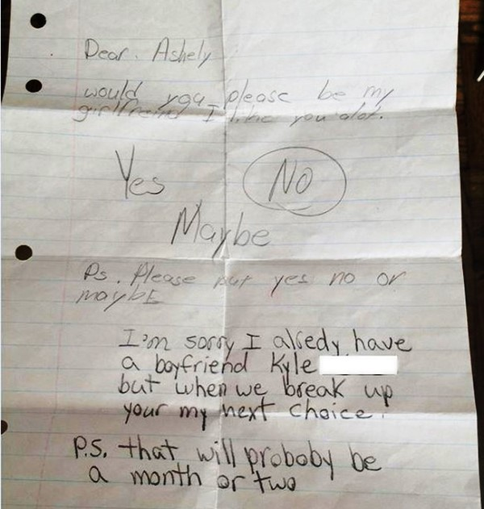

Slide 6
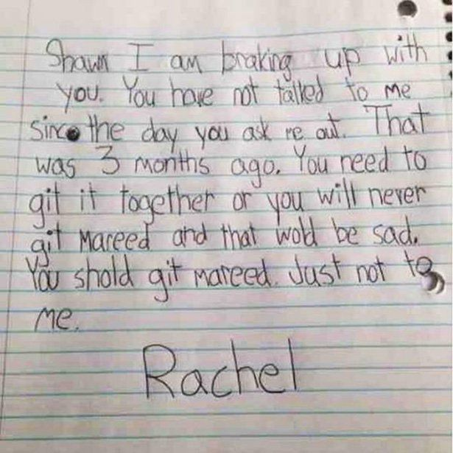

Slide 7
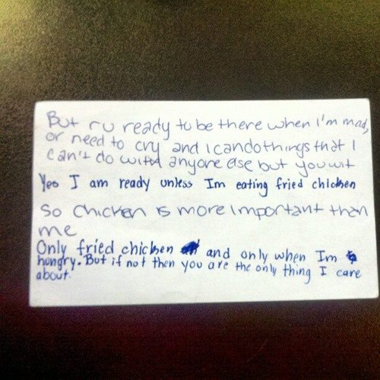

Slide 8
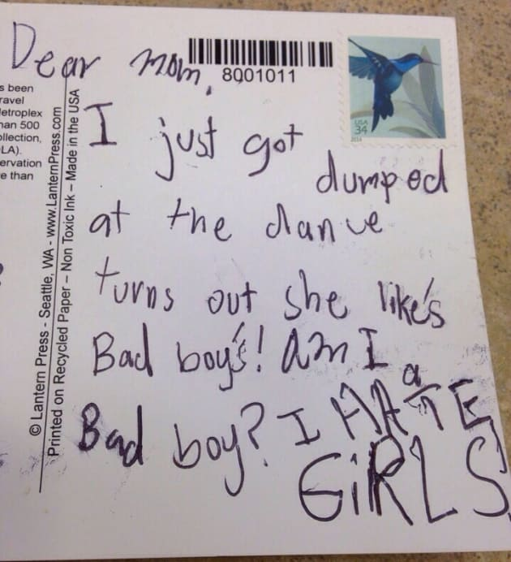

Slide 9
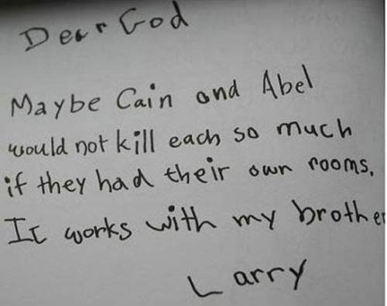

Slide 10
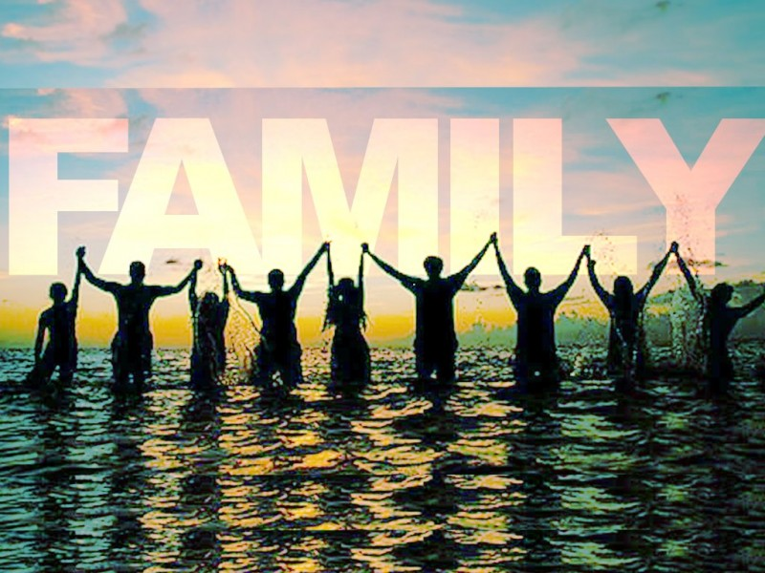
For beauty and clarity to be revealed you need context.
Example: Diamond in setting.
The Family of God is the context where the Nature and Kingdom of God are best displayed.

Slide 11
Matthew 6:9
“Our Father in heaven, Hallowed be Your name.”
Ephesians 3:14
“For this reason I bow my knees to the Father of our Lord Jesus Christ, from whom the whole family in heaven and earth
is named,…”

Slide 12
“Communion is strength; solitude is weakness. Alone, the fine old beech yields to the blast and lies prone on the meadow. In the forest, supporting each other, the trees laugh at the hurricane. The sheep of Jesus flock together. The social element is the genius of Christianity.”
C.H. Spurgeon

Slide 13
Many people think that Christianity is a belief system, but it’s really a belong system.
John 13:35
“By this all will know that you are My disciples, if you have love for one another.”

Slide 14
John 15:12
“This is My commandment, that you love one another as I have loved you.”
The New Covenant
HAS
A New Commandment

Slide 15
Dr Dean Ornish
Ornish Lifestyle Medicine
“Love and intimacy — our ability to connect with ourselves and others, is at the root of what makes us sick and what makes us well, … People who feel lonely and isolated have a 300-500 percent greater risk of premature death due to
physical illness.”

Slide 16
Niel Clark Warren
Founder of “E Harmony”
Asked if you could just give one word of advice what would it be? “Get yourself healthy before you get yourself married.”

Slide 17
“If you try to build intimacy with another person before you have done the work of getting whole on your own, all your relationships become an attempt to complete yourself.” Dr. Les Parrot
Worst Movie Quote!
“You Complete me.”
Jerry Maguire

Slide 18
Ephesians 3:14- 4:3 Message
“My response is to get down on my knees before the Father, this magnificent Father who parcels out all heaven and earth. I ask him to strengthen you by his Spirit—not a brute strength but a glorious inner strength—that Christ will
live in you as you open
the door and invite him in.”

Slide 19
And I ask him that with both feet planted firmly on love, you’ll be able to take in with all followers of Jesus the extravagant dimensions of Christ’s love.
Reach out and experience the breadth! Test its length! Plumb the depths! Rise to the heights!
Live full lives, full in the
fullness of God.

Slide 20
God can do anything, you know—far more than you could ever imagine or guess or request in your wildest dreams! He does it not by pushing us around but by working within us, his Spirit deeply and gently within us.
Glory to God in the church! Glory to God in the Messiah, in Jesus! Glory down all the generations! Glory through all millennia! Oh, yes!

Slide 21
In light of all this, here’s what I want you to do. While I’m locked up here, a prisoner for the Master, I want you to get out there and walk—better yet, run!—on the road God called you to travel. I don’t want any of you sitting around on your hands.

Slide 22
I don’t want anyone strolling off, down some path that goes nowhere. And mark that you do this with humility and discipline—not in fits and starts, but steadily, pouring yourselves out for each other in acts of love, alert at noticing differences and
quick at mending fences.

Slide 23
3 Essentials For Healthy Relating
1. Embrace Your Value
“… extravagant dimensions of Christ’s love…”
Matthew 6:26 “Are you not of more value than they?”
Philippians 4:19 “And my God shall supply all your
need…”

Slide 24
2. Be Yourself
“…road God called you to travel…”
You are unique. There is no one like you. Don’t be a copy
Psalm 139:14 “I will praise you, for I am fearfully and wonderfully made;”

Slide 25
“Transformation is my favorite game and in my experience, anger and frustration are the result of you not being authentic somewhere in your life or with someone in your life. Being fake about anything creates a block inside of you. Life can’t work for you if you
don’t show up as you.”
Jason Mraz

Slide 26
3. Express Selfless Love
“…steadily, pouring yourselves out for each other in acts of love,…”
You walk into a room and everyone else is of great value to you.
Philippians 2:3
“Don’t be selfish; don’t try to impress others. Be humble, thinking
of others as better than
yourselves.”

Slide 27
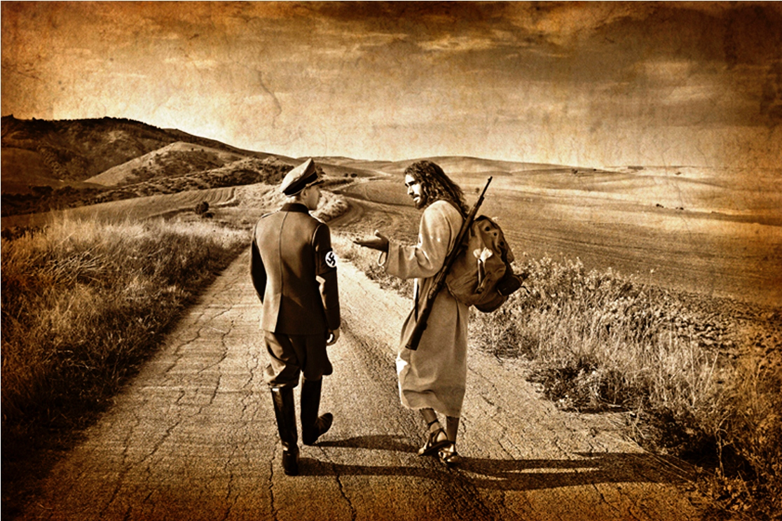
MICHEAL BELK “Journeys with the Messiah”

Slide 28
Matthew 5:41
“And whoever compels you to go one mile, go with him two.”
Historians write that many Jews would step off the 1,000 paces in front of their property and post markers. carry the load from marker to marker and not one inch more.
Jesus words would have abruptly confronted the status quo.

Slide 29
Genesis 24:10-24
“And when she had finished giving him a drink, she said, “I will draw water for your camels also, until they have finished drinking.” Then she quickly emptied her pitcher into the trough, ran back to the well to draw water, and drew for all his camels.”

Slide 30
10 Camels …at least.
17 day journey … 435 miles.
Camel can drink 20-30 gallons of water in 10 minutes.
She RAN … QUICKLY.
Busiest time at the well.
A two hour commitment to
some heavy lifting.

Slide 31
What would shift if you watered the camels in your marriage?
What would shift if you watered the camels at your work place?
What would happen if you watered the camels of neighbours?
2nd MILE LIFE!

Slide 32
John 15:12
“This is My commandment, that you love one another as I have loved you.”
The New Covenant
HAS
A New Commandment

