Slide 2
Miracles:-- a supernatural intervention in the ordinary course of nature; by the power of God nature is suspended, altered or controlled.

Slide 3
“It is abnormal for a Christian not to have an appetite for the impossible. It has been written into our spiritual DNA to hunger for the impossibilities around us to bow at the name of Jesus.”
Bill Johnson

Slide 4
God wants the earth full of the knowledge of His glory.
Christmas is the Spirit of God colliding with the natural realm to manifest His glory in what can be seen.

Slide 5
1 John 1:8
“For this purpose the Son of God was manifested, that He might destroy the works of the devil.”

Slide 6
Mark 1:7-8
“And he preached, saying, ‘There comes One after me who is mightier than I, whose sandal strap I am not worthy to stoop down and loose. I indeed baptized you with water, but He will baptize you with the Holy Spirit.’”

Slide 7
Christ —the Anointed One, to smear, to rub, to pour.”
Mass — celebration or physical substance and weight.
Christmas is a celebration of the consecration and smearing of all physical substance by the birth of Jesus, Christ, the Lord.

Slide 8
Luke 1 :26-38
“‘For with God nothing (rhema) will be impossible.’ Then Mary said, ‘Behold the maidservant of the Lord! Let it be to me according to your word.’ And the angel departed from her.”

Slide 9
A silent invasion through a little gift, silently given, and strangely wrapped. A movement begins that would overthrow all the kingdoms of this world.
Revelation 11:15 “The kingdoms of this world have become the kingdoms of our Lord and of His Christ, and He shall reign...”

Slide 10
God is still invading this rebellious planet. His invasion strategy is still the same.
He wants to plant Himself in you and continue His miraculous invasion.
Colossians 1:27 “Christ in you the hope of Glory.”

Slide 11
1. The Announcement
“For with God nothing shall be impossible” vs. 37
Jeremiah 32:27 “Behold, I am the, the God of all flesh; is there anything too hard for Me?”
We need to get reacclimatized to the supernatural.

Slide 12
2. The Assignment
“...bring forth a son ... the son of the Highest...” vs. 31-32
2 Corinthians 4:7 “But we have this treasure in earthen vessels, that the excellence of the power may be of God and not of us.”
Entrusted cosmic redemption to a teen … and now YOU!!!

Slide 13
3. The Acceptance
This is a demanding assignment.
a. It has challenges.
Luke 1:38 “Let it be to me according to your word.”
She exercised complete consecration!
She willingly risked everything! She partnered in the miraculous!

Slide 14
Matthew 1:20
“But while he thought about these things, behold, an angel of the Lord appeared to him in a dream, saying, ‘Joseph, son of David, do not be afraid to take to you Mary your wife, for that which is conceived in her is of the Holy Spirit.’”
It does impact your
immediate relationships.

Slide 15
b. It has contradictions.
Luke 2:7
“ And she brought forth her firstborn Son, and wrapped Him in swaddling cloths, and laid Him in a manger, because there was no room for them in the inn.”

Slide 16
Matthew 2:11
“…they saw the young Child with Mary His mother, and fell down and worshiped Him. And when they had opened their treasures, they presented gifts to Him: gold, frankincense, and myrrh.”

Slide 17
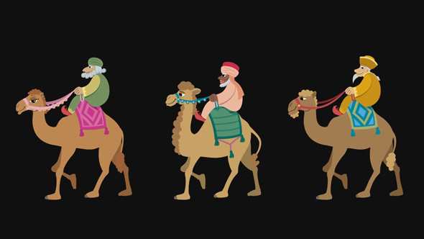

Slide 18
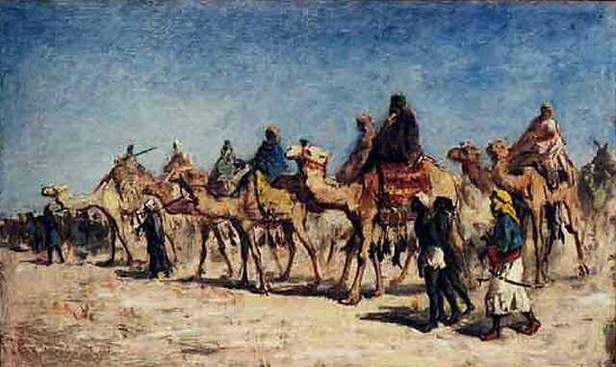

Slide 19
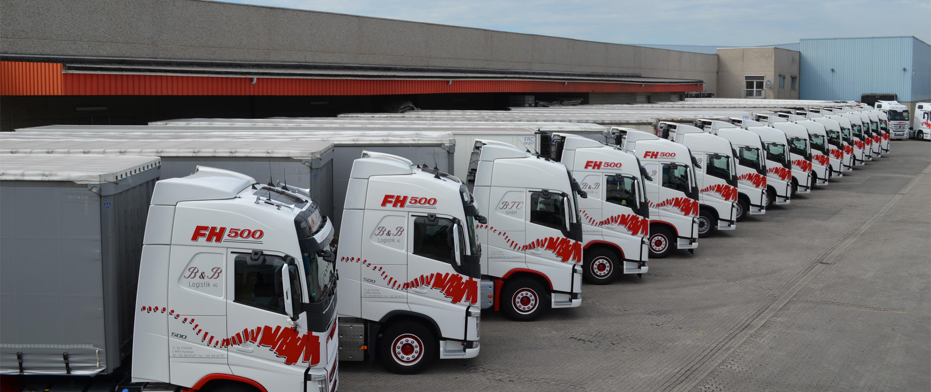

Slide 20
Matthew 2:1-3
“…wise men from the East came to Jerusalem, saying, ‘Where is He who has been born King of the Jews? For we have seen His star in the East and have come to worship Him.’ When Herod the king heard this, he was troubled, and all Jerusalem with him.”

Slide 21
C. It has conflicts
Luke 2:34-35 “‘Behold, this Child is destined for the fall and rising of many in Israel, and for a sign which will be spoken against (yes, a sword will pierce through your own soul also), …’”
There is no handle on the Word.
It will pierce you.

Slide 22
Matthew 13:55-57
“Is this not the carpenter’s son? Is not His mother called Mary? And His brothers James, Joses, Simon, and Judas? And His sisters, are they not all with us? Where then did this Man get all these things?” So they were offended
at Him.”

Slide 23
Mark 3:21, 30-35
“When his family heard about this, they went to take charge of him, for they said, ‘He is out of his mind.’ … ‘Your other and brothers are outside looking for you.’ ‘Who are my mother and my brothers?’ he asked … ‘Whoever does God’s will is my brother and sister
and mother.’”

Slide 24
John 19:25
“Now there stood by the cross of Jesus his mother,...”
How could this happen to God’s promise to me!

Slide 25
d. It has consummation
Acts 1:14
“These all continued with one accord ... and Mary the mother of Jesus,...”
Mary carried the anointed one to full term … birth and nurtured.
Now Christ in her again!

Slide 26
Acts 2:3-4
“Then there appeared to them divided tongues, as of fire, and one sat upon each of them. And they were all filled with the Holy Spirit and began to speak with other tongues, as the Spirit gave them utterance.”

Slide 27
Colossians 1:27
“Christ in you the hope of Glory.”
Who or what awaits an invasion of the miraculous that can only be realized as we release the manifestation of Christ in us!

Slide 28
At Christmas the volume gets turned up!
Jesus met the pain head on!
God wants to do the impossible through you!

